Slide 1

Introduction to AI(AI101B) Even Semester Session 2024-25
Email Spam Classification Using Naïve Bayes
Team Leader: Ridhi Rajput (2426MCA334)
Member: Sanket Pundhir(2426MCA503)
Member: Namrta Singh(2426MCA680)
Project Supervisor:
Ms. Komal Salgotra
Assistant Professor

Slide 2

Content
Introduction
Sustainable Development Goal
Objective of the Project
Methodology
Flowchart
Results
References
Notes:
Font Styles: Times New Roman + Font Size: 25

Slide 3
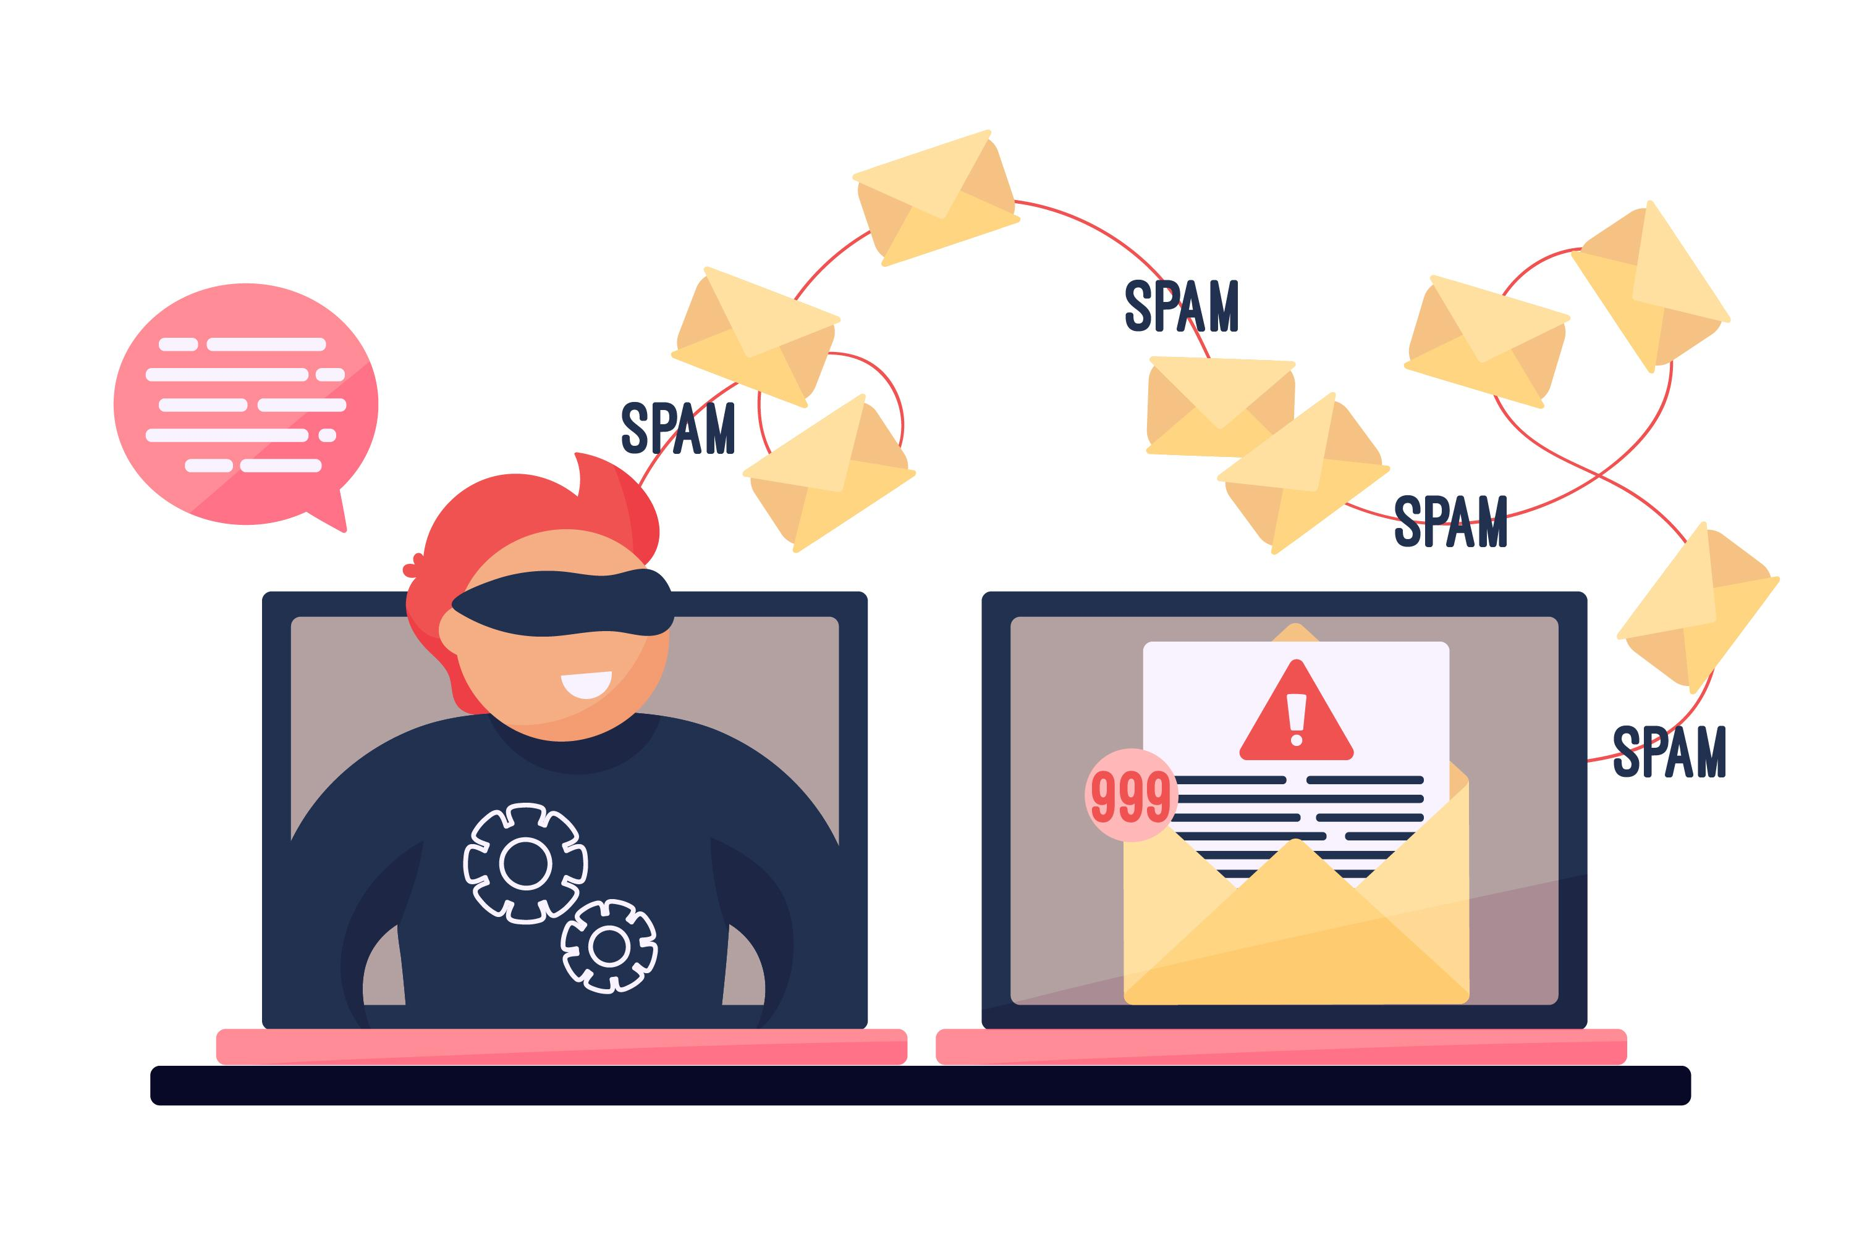
Introduction
In today’s digitally connected world, email has become an essential mode of communication for both personal and professional purposes. However, the effectiveness of this communication channel is heavily compromised by the exponential rise in spam emails. These unsolicited messages not only clutter inboxes but often carry malicious intent — from phishing scams to the distribution of harmful software.
The main problem addressed in this project is the automatic classification of email messages into "Spam" or "Not Spam" using a machine learning-based approach that ensures higher accuracy, adaptability, and user-friendly accessibility through a web-based interface.
Notes:
Font Styles: Times New Roman + Font Size: 25

Slide 4

Sustainable Development Goal
Our project will likely contribute to Sustainable Development Goal 9 (SDG 9):Industry, Innovation and Infrastructure.
How It Relates to SDG 9 (Industry, Innovation and Infrastructure)?
Innovation through AI/ML: Our project uses machine learning (Naive Bayes) to detect spam, which showcases technological innovation.
Secure & Efficient Communication: By filtering spam, it improves the efficiency of digital infrastructure, supporting safe tech environments.
Support for Digital Transformation: Helps organizations minimize time loss and security risks, which supports innovation and resilience in industry.

Slide 5
Objective of the Project
Data Preprocessing & Model Training
Clean and preprocess textual email data and train a Naive Bayes classification model for spam detection using a labeled dataset.
Efficient Text Classification
Convert email text into numerical vectors using feature extraction techniques (e.g., CountVectorizer or TF-IDF).
Real-Time Prediction and Feedback
User Experience and Accessibility
Provide users with real-time feedback on whether the email is spam or not.
Incorporate modern design features such as background videos, glowing animations, and responsive layouts to ensure the app is both functional and engaging.
Notes:
Font Styles: Times New Roman + Font Size: 25

Slide 6
Methodology
Data Collection & Preprocessing
A publicly available dataset containing labeled email messages (as spam or not spam) was used.
This preprocessing ensured that only meaningful features were passed to the model.
2. Feature Extraction
Each email message was represented as a vector based on the importance of each word in the corpus.
3. Model Selection and Training
The Naive Bayes classifier, particularly Multinomial Naive Bayes, was chosen due to its effectiveness in text classification tasks.
The model was trained on the training set using the vectorized features.

Slide 7

Methodology
4. Model Serialization
Once trained and tested, the model and the TF-IDF vectorizer were serialized using Python’s pickle library.
This allowed the model to be reused without retraining each time the application runs.
5. Web Application Development
A background video and glowing elements were added for visual appeal.
The backend was built using Flask, a lightweight Python web framework.
6. User Interface Enhancements
Added a responsive layout with animations and effects.
Included background video and images (e.g., shield for Not Spam, ad symbol for Spam).
Result section styled with glowing borders and color-coded backgrounds for clarity.

Slide 8
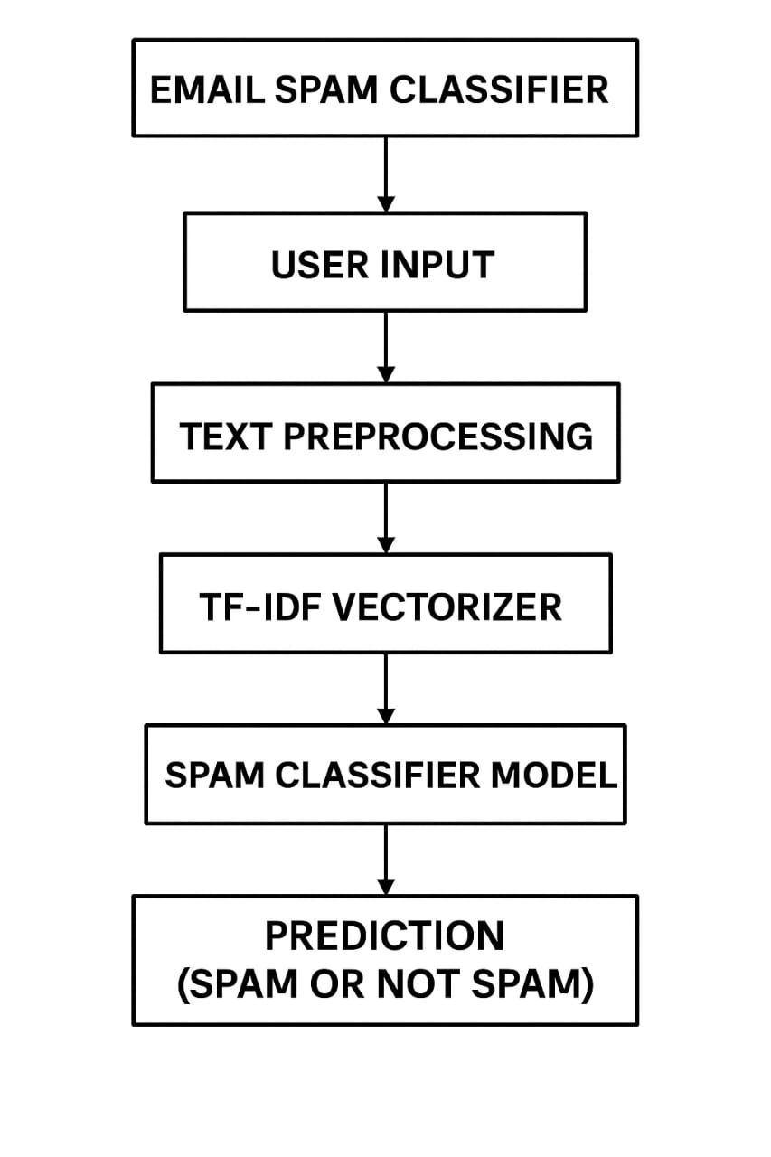
Flowchart

Slide 9
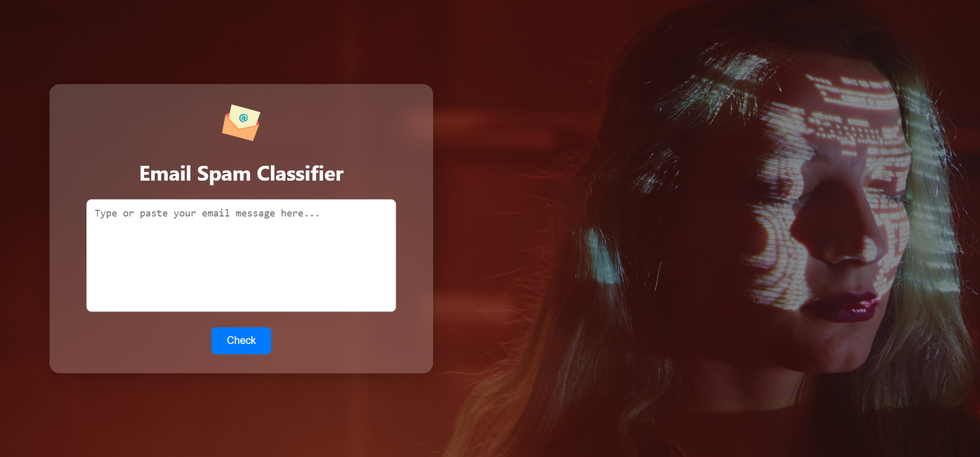
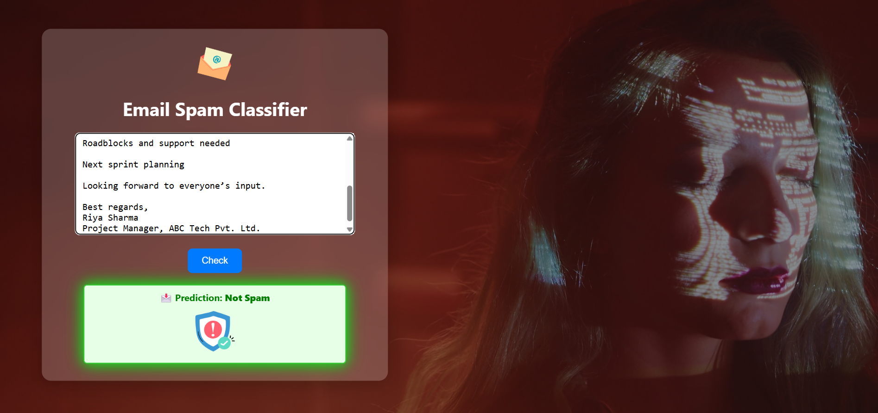
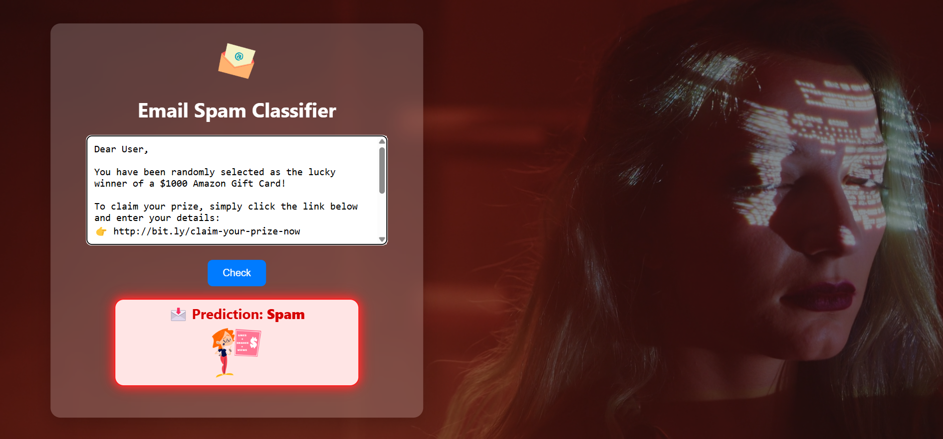
Results
Check Email Spam Or Not Spam
Prediction: Not Spam
Prediction: Spam
Notes:
Font Styles: Times New Roman + Font Size: 25

Slide 10
References
1. Scikit-learn: Machine Learning in Python
https://scikit-learn.org/
2. Natural Language Toolkit (NLTK)
https://www.nltk.org/
3. SpamAssassin Public Corpus – Dataset used for spam/ham classification.
https://spamassassin.apache.org/publiccorpus/
4. Python Official Documentation
https://docs.python.org/3/

Slide 11

THANK YOU!

